Slide 1
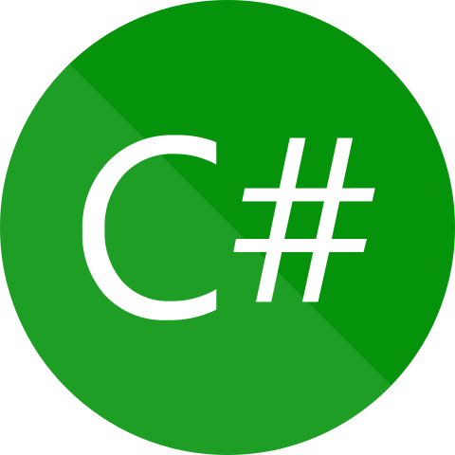

Swapping Of Two Numbers Without Using Third Variable In C#
Presenter: Mohammad Adil
C# Interview Questions
And Answers

